Slide 1




CRIME + SAFETY
A DATA-DRIVEN ANALYSIS
Beyond the Rankings
27 EU NATIONS
TRENDS
GEOGRAPHY
Why Europe's Crime Data Tells a Different Story
PRESENTED BY
Victoria Antai Bassey
Student Number: 948253
v.bassey@campus.unimib.it
10 YEARS
CROSS-BORDER
Based on Eurostat Crime Statistics · 2014–2023

Slide 2
The Questions That Matter
01
Do crime rankings actually reflect real risk — or just population size?
02
What happens when we look at trends over time instead of snapshots?
03
Can profiling countries reveal more than simply ranking them?

Slide 3




About the Data
DATA FOUNDATION
DATA SOURCE
COVERAGE
Data sourced from Eurostat — the official EU statistics database
Covers crime counts across European countries
Includes data from 2014 to 2023
DATA PREPARATION
KEY INSIGHT
Combined with population data for fair comparison
Based on police-recorded offences
Raw crime counts alone can be misleading without population context.

Slide 4


The Game Plan
METHODOLOGY
DATA PREPARATION
ANALYTICAL APPROACH
Cleaned and structured data for consistency across countries
Standardised crime metrics for comparison
Compared raw crime totals vs per capita rates
Analysed trends over time (2014–2023)
Grouped countries based on risk level and trend direction
VISUALISATION
Analysis and visualizations created with Python, pandas, and Matplotlib
Background visuals on slide 1 was created using CANVA AI.

Slide 5
The Ranking Illusion
France, Germany, and Italy dominate the raw numbers — but this reflects population size, not actual risk per person.
EU Countries Ranked by Raw Crime Value (2023)

Slide 6
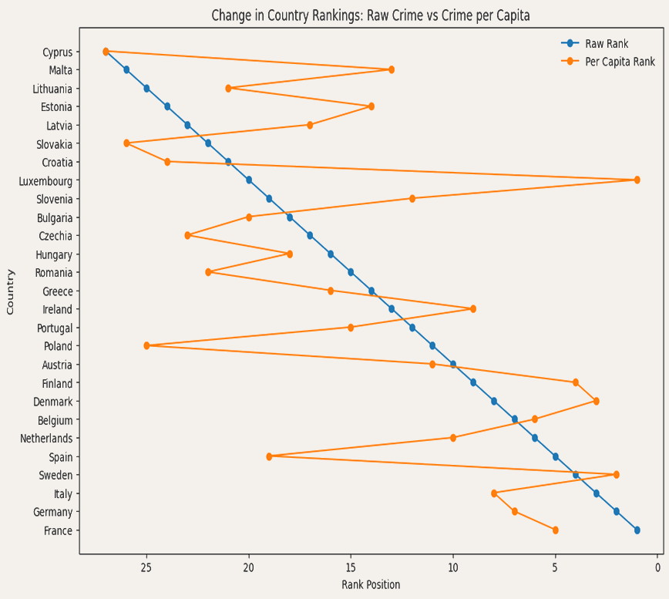
The Population Effect
Large countries appear most dangerous by raw count, but per capita data tells a completely different story. France, Germany, and Italy drop to the bottom when adjusted for population, while smaller nations like Luxembourg and Finland rise to the top.

Slide 7
The Trend Factor
Crime isn't static. Over the past decade, countries like Romania and Czechia have seen dramatic decreases, while Luxembourg and Spain are trending sharply upward.
Crime Trend in EU Countries (2014–2023)
■ Increasing
■ Decreasing
Trend % = relative percentage change in recorded offences between 2014 and 2023

Slide 8


The Data Has Blind Spots
Hidden Crime
Reporting Gaps
Different Rules
Official statistics only capture reported incidents. The true level of crime is likely higher, as many go unreported.
Trust in police, cultural norms, and awareness levels vary widely — meaning some countries report far more than others.
Legal definitions of crime differ across borders. The same act may be classified differently from country to country.

Slide 9
Beyond the Rankings
Where risk meets momentum — four profiles that tell a deeper story than any league table
Crime Profiling of EU Countries: Risk per Person vs Trend
Instead of asking which country is worst, this approach asks a better question: “where is risk high”, and is it getting better or worse? That gives us a much clearer understanding of safety across countries.
Countries are grouped into four profiles:
High Risk + Increasing — high crime rates that are still growing (e.g. Luxembourg, France)
High Risk + Decreasing — high crime rates but trending downward (e.g. Germany, Denmark)
Low Risk + Increasing — lower crime rates but on the rise (e.g. Italy, Croatia)
Low Risk + Decreasing — lower crime rates and improving further (e.g. Poland, Romania)
● High Risk + Increasing ● High Risk + Decreasing ● Low Risk + Increasing ● Low Risk + Decreasing

Slide 10
What the Data Really Shows
01
Rankings Oversimplify
Raw crime counts favor larger nations and hide the real story.
02
Population Reshapes the Picture
Per capita data reveals that smaller countries often carry higher individual risk.
03
Trends Show Direction
A country's crime rate matters less than whether it's rising or falling.
04
Profiling Reveals the Truth
Combining risk level with trend direction creates a far clearer safety picture.

Slide 11
The real question isn't which country is most dangerous — it's how we choose to measure danger.
Rankings simplify. Profiling illuminates. The data tells a richer story when we ask better questions.
Based on Eurostat Crime Statistics · 2014–2023

Slide 12

LICENSE
SOURCES & TOOLS
© Victoria Bassey, 2026
Data Sources
Eurostat – Police-recorded offences
https://ec.europa.eu/eurostat/databrowser/view/crim_off_cat/default/table
Eurostat – Population Data (demo_pjan) https://ec.europa.eu/eurostat/databrowser/view/demo_pjan/default/table
© European Union
Licensed under
CC BY-NC-SA 4.0
Creative Commons
Attribution-NonCommercial-ShareAlike
4.0 International
Charts & Visualizations
Analysis and visualizations created with Python, pandas, and Matplotlib
Backgrounds & Design
Background visuals on Slide 1 was created using CANVA AI, used under CANVA’s content license for non- commercial and educational purposes.
https://creativecommons.org/licenses/by-nc-sa/4.0/
Presentation Link
Rethinking Crime Rankings in Europe final.pptx
Sources & Attribution

